Slide 1
MIDNAPORE COLLEGE (AUTONOMOUS)
Travelling Salesman Problem Using
Genetic Algorithm
Guide : Prof. Shovan Roy (Dept. of CSA )
BCA-5TH Sem.-(Project)
Presented By :
Arun Sarma - 1733
Suman Paik - 1737
Rohan Das - 1734
Sumit Mandal - 1736

Slide 2
Introduction
The Travelling Salesman Problem (TSP) is a cassical combinatorial olptimization problem, which is simple to state but very difficult to solve. The problem is to find the shortest tour through a set of N city so that each city is visited exactly once.In this presentation we provide overview of Genetic Algorithm Which is used for solving the travelling salesman problem.

Slide 3
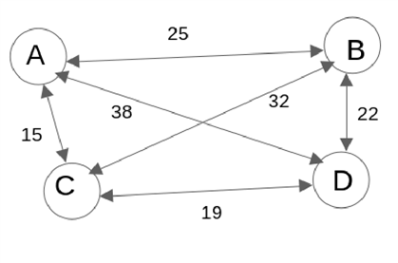
Let us consider that we have a set of four cities A, B, C and D. Distances between cities are given us. Here the route can be generated (4-1)! means 6.
In this figure, all tour and cost
1) A - B - D - C - A -> 25 + 22 + 19 + 15 =81 4) A - C - B - D - A -> 15 + 32 + 22 + 38 = 107
2) A - B - C - D - A ->25 + 32 + 19 + 38 =114 5) A - D - B - C - A -> 38 + 22 + 32 + 15 = 107
3) A - C - D - B - A -> 15 + 19 + 22 + 25 = 81 6) A - D - C - B - A -> 38 + 19 + 32 + 25 = 114

Slide 4
TSP Variations:
Asymmetric and symmetric TSP

Slide 5
Asymmetric and symmetric TSP
There are two main forms of TSP - symmetric TSP (STSP) and asymmetric TSP (ATSP).In the case of STSP, the distance between the two cities is the same in each opposite side, so also the cost. In ATSP, the distance between two cities is different when travelling in the opposite direction; the costs may vary; at times only one-way traffic is allowed on the way from one city to another.TSP is relatively easier to solve than ATSP, since symmetry halves the number of possible solutions.

Slide 6
Various Method For Solving TSP:
→ Method of total enumeration
→ Brute force Approach
→ Greedy approach
→ Dynamic Programming Approach
→ Nearest Neighbourhood Method
→ Branches and bounds Technique
→ Genetic Algorithm
→ Ant Colony Optimization Algorithm(ACO)

Slide 7
Genetic Algorithm

Slide 8
What is Genetic Algorithm :
→ A genetic algorithm is a heuristic search algorithm used to solve search and optimization problems.
→ Genetic algorithms are inspired by the concept of genetics and natural selection to provide best solutions to problems. GA is based on the behaviour of chromosomes and their genetic structure. Every chromosome plays the role of providing a possible solution. The fitness function helps in providing the characteristics of all individuals within the population. The greater the function, the better the solution.

Slide 9
Basic Terminologies used in Genetic Algorithm :
→ Population:
This is a subset of all the probable solutions that can solve the
given problem.
→ Chromosomes:
A chromosome is one of the solutions in the population.
→ Gene:
This is an element in a chromosome.
→ Allele:
This is the value given to a gene in a specific chromosome.

Slide 10
Genetic Algorithm follows the upcoming phases to solve complex optimization problems:

Slide 11
Initialization
The genetic algorithm starts by generating an initial population. This initial population consists of all the probable solutions to the given problem. The most popular technique for initialization is the use of random binary strings.
Here in our TSP we will use decimal strings that will represent each route.

Slide 12
Fitness assignment
The fitness function helps in establishing the fitness of all individuals in the population. It assigns a fitness score to every individual, which further determines the probability of being chosen for reproduction. The higher the fitness score, the higher the chances of being chosen for reproduction.

Slide 13
Selection Strategy for Reproduction
In this phase, individuals are selected for the reproduction of offspring. The selected individuals are then arranged in pairs of two to enhance reproduction. These individuals pass on their genes to the next generation. The main objective of this phase is to establish the region with high chances of generating the best solution to the problem (better than the previous generation). The genetic algorithm uses the fitness proportionate selection technique to ensure that useful solutions are used for recombination.

Slide 14
Some popular selection method :
→ Tournament Selection
→ Roulette Wheel Selection

Slide 15
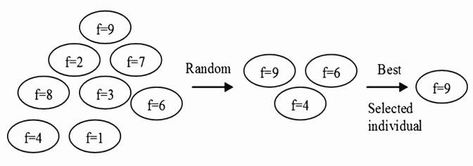
Tournament Selection
Tournament selection is probably the most popular selection method of genetic algorithm due to its efficiency and easy implementation. In Tournament Selection, N individuals are randomly selected from a larger population, and the selected individuals compete against each other. All individuals with the highest fitness will be the winner and included as one of the next generation population. Tournament selection gives everyone the opportunity to be selected and thus preserves diversity(although maintaining diversity can slow down the pace of engagement).
f is defined as fitness score

Slide 16
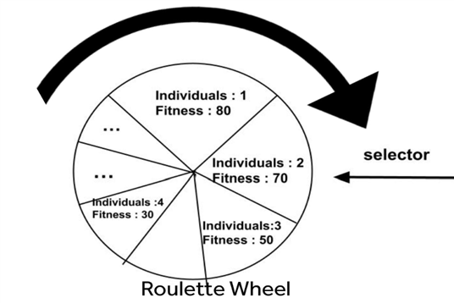
Roulette Wheel Selection
In a roulette wheel selection, the circular wheel can be divided randomly. A fixed point is chosen on the wheel circumference as shown and the wheel is rotated. The region of the wheel which comes in front of the fixed point is chosen as the parent. For the second parent, the same process is repeated. Here in this division of roulette wheel the larger the fitness value is, the chance of getting selected is higher.

Slide 17
Elitism
In this phase the best one or more solutions, called the elites, in each generation, inserted into the next, without undergoing any change. This strategy usually speeds up the convergence of the algorithm.

Slide 18
Crossover
This operator swaps the genetic information of two parents to reproduce an offspring. It is performed on parent pairs that are selected from the selection process to generate a child population.

Slide 19
Types of Crossover Operator :
→ Order Crossover
→ Cycle Crossover
→ Partially Mapped Crossover (PMX)
→ Multi-Parent Crossover

Slide 20
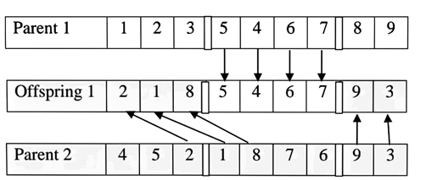
Order Crossover
In this case of order crossover, a portion of the first parent is copied to the offspring chromosome and the remaining values are placed in the offspring. Now select two cut points randomly in each parent's genes.The consecutive alleles between two cut points from Parent 1 are copied to the Offspring 1. Then, the remaining genes are copied from the second cut point in the order in which Parent 2 starts after the second cut point till all positions are filled.
( Order Crossover to generate offspring )

Slide 21
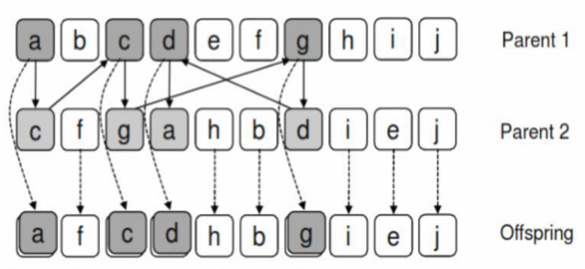
Cycle Crossover
In this crossover method, a gene from one parent will be copied into an offspring, but it should go through the position of the other parent
Representation of formation of cycle

Slide 22
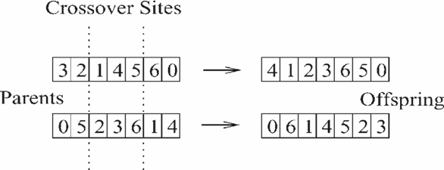
Partially Mapped Crossover (PMX)
PMX stands for partially matched crossover, and it works in a similar way to two-point crossover. Two crossover points are chosen among two parents in this procedure, and the genes between the two crossover points are exchanged, while the remaining genes are filled by partial mapping.

Slide 23
Mutation
This operator adds new genetic information to the new child population. This is achieved by flipping some bits in the chromosome. Mutation solves the problem of local minimum and enhances diversification.

Slide 24
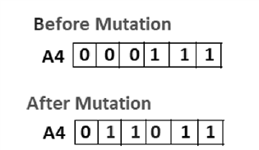
Mutation process :
In the case of Random Mutation some individuals are picked at random to be mutated, and then a mutation point is chosen at random. The character in the string's corresponding position is altered.
Types of mutation : single-point, multiple-point, random-point mutation.

Slide 25
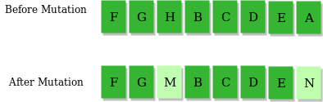
Mutation in terms of Rate :
Here the Mutation is described in terms of a rate.like 5% or 1% or maybe 0.1% that is given to the genetic algorithm.Let's assume we just finished with crossover and ended up with the child. If we have a mutation rate of 1%, this means that for each character in the phrase generated from crossover, there is a 1% chance that it will mutate
Child or offspring

Slide 26
Termination
A stopping criterion is used to provide the basis for termination. The algorithm will be repeated until the threshold fitness solution has been attained. It will identify this solution as the best solution in the population.

Slide 27
REPRESENTATION OF
GENETIC ALGORITHM

Slide 28
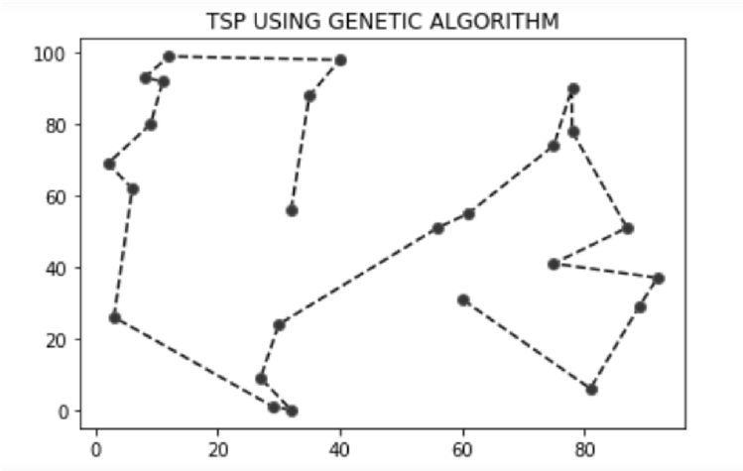
Representation of TSP :
.

Slide 29
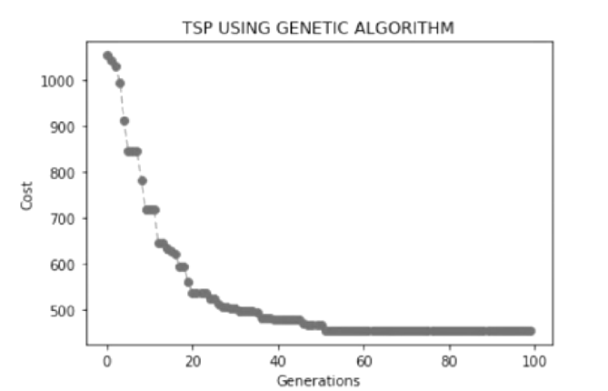
Performance graph & the best solution route :
Total Generation | Mutation Rate | Population Config | Time

Slide 30
Limitations of genetic algorithms
1) They are not effective in solving simple problems.
2) Lack of proper implementation may make the algorithm converge to a solution that is not optimal.
3) The quality of the final solution is not guaranteed.
4) Repetitive calculation of fitness values may cause some problems to experience computational challenges.

Slide 31
Conclusion
The TSP problem and cannot be solved in polynomial time when the points are so large in number. Many algorithms have been developed in this case. But here through the Genetic Algorithm approach this problem is solved with much more efficient way. And this is the main motive of this project

Slide 32
Future work :
Study of more crossover, mutation & selection techniques .
Implementation of those techniques in program.
Through the implementation and observing the result of this different techniques we will do a comparison survey among them.

Slide 33
REFERENCES
[1] Genetic Algorithm for the TSP, 5 authors: january 1999 (Padro Larranaga,Cindi Kuijper and 3 other respected), Ackley, D. H. (1987). A Connectionist Machine for Genetic Hillclimbing. Kluwer Academic Publishers. Ambati, B. K., Ambati, J. & Mokhtar, M. M. (1991). Heuristic Combinatorial Optimization by Simulated Darwinian Evolution: A Polynomial Time Algorithm for the Travelling Salesman Problem. Biological Cybernetics 65: 31–35.
[2] Calgor, H. (12 January 2017). The Brute force algorithms
[3] StefanHougardy, M. (November 2015). On the nearest neighbour rule for the metric travelling salesman problem. Discrete Applied Mathematics,
[4] Rabanal P., Rodríguez I., Rubio F.: Using River Formation Dynamics to Design Heuristic Algorithms, Springer, 2007
[5] Laurentiu Rudeanu, Mitica Craus: Parallel Implementation of Ant Colony Optimization for Travelling Salesman Problem, Proceedings of the 4th WSEAS Int. Conf. on Soft Computing,
Optimization, Simulation & Manufacturing Systems (SOSM 2004), Miami, Florida, April 21-23, 2004

Slide 34
→ THE END OF PROJECT ←
Presented By-
Suman Paik
Arun Sharma
Rohan Das
Sumit Mandal
(BCA 5th SEM)

